Slide 1

DEPARTMENT OF COMPUTER SCIENCE AND ENGINEERING
Project name : Smart Water Fountain
Team name : Proj_224781_Team_6
Team members :
KIRUTHIKA .K(113321104046)
KUNCHALA SRIHEMA(113321104049)
LAVANYA .V(113321104050)
MAHI MITHRA. R(113321104054)

Slide 2
Project Definition
A smart water fountain project aims to enhance the maintenance of the fountain by installing IoT sensors to monitor the water quality and detect malfunctions.
This project includes defining objectives, designing the IoT sensor system, developing the water fountain, and integrating them using IoT.

Slide 3
OBJECTIVES
Through a network of sensors, the system collects real-time data on water quality. This data is processed in cloud based platform.
Ensure water quality maintenance and address water management challenges, including water usage and tank overflow.
Monitor parameters such as water flow rate, pressure, temperature, pH levels, turbidity, and contaminants
Use wireless communication protocols to transmit data securely and efficiently

Slide 4
PROJECT Requirements
Real-Time Water Fountain Monitoring: Implement IoT sensors to monitor the status of public water fountains in real-time, including water flow rates and water quality.
Efficient Water Usage: Optimize water by detecting anomalies, leaks, or inefficient water flow patterns.
Malfunction Detection: Develop mechanisms to detect malfunctions or maintenance requirements promptly.
Resident Awareness: Create a public platform (e.g., mobile app) to provide residents with real-time information about water fountain status and quality

Slide 5
Sensor Design
Flow rate sensors: Model XYZ123. It is used to know the usage of water litre per hour.
Pressure sensors: Model ABC456. Pressure sensors can be used to monitor water pressure within the fountain system
Water quality sensors: pH Sensor – Model DEF789,Turbidity Sensor - Model UVW987
Water Level sensor: Automatically controls the minimum and maximum water levels of architectural fountains.
Distance sensor:Combine the distance sensor with an LED display or water jets that respond to the user's proximity.

Slide 6
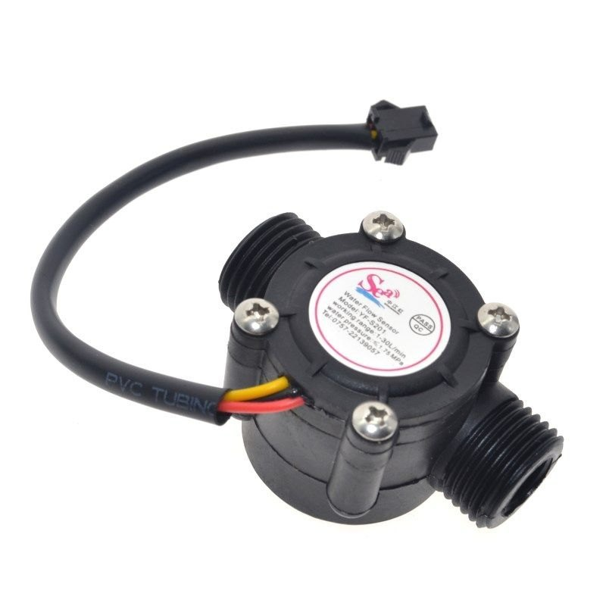
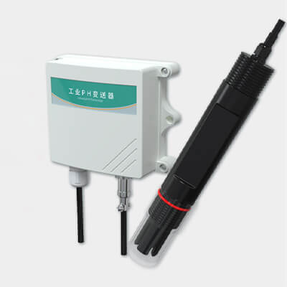
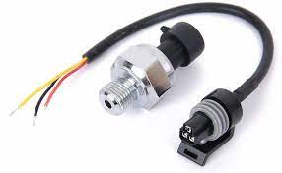
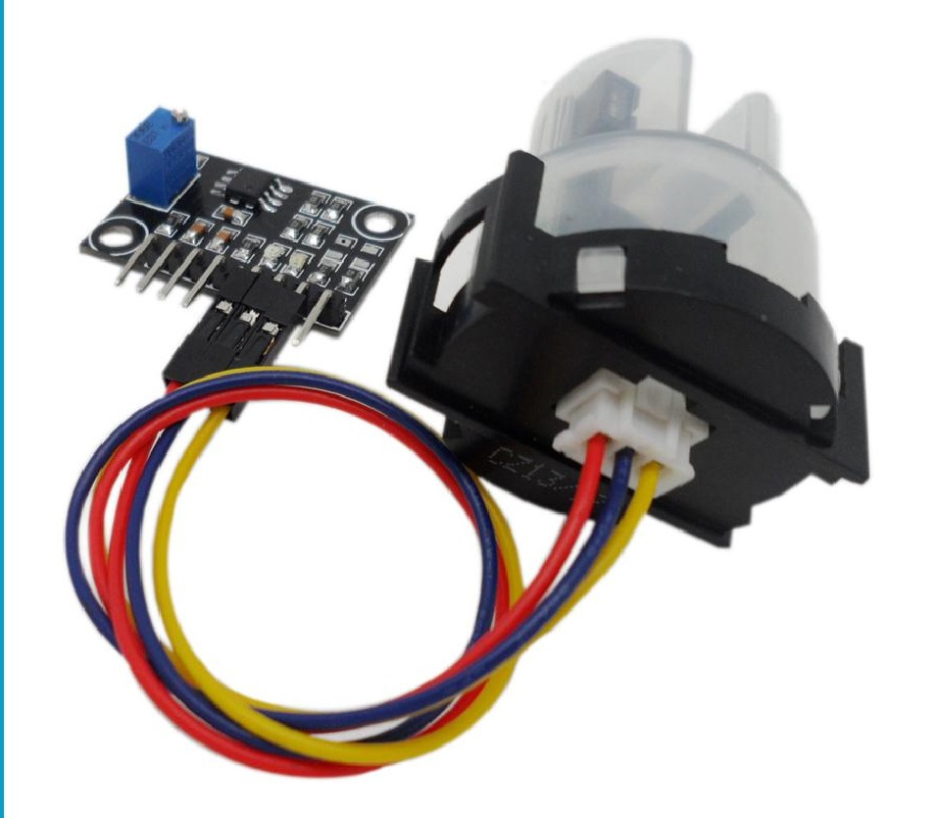
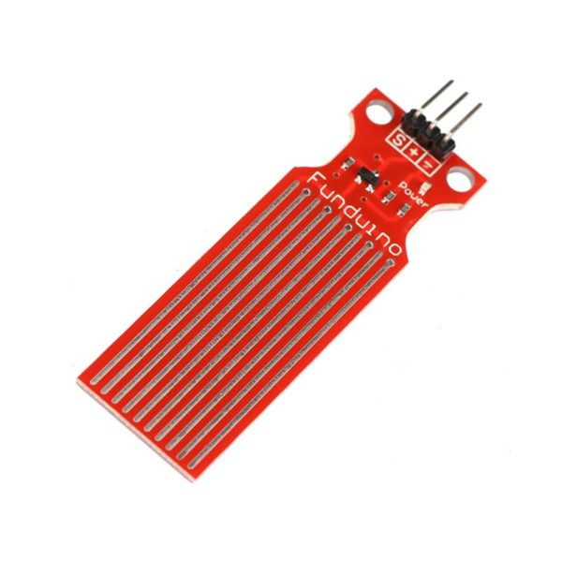
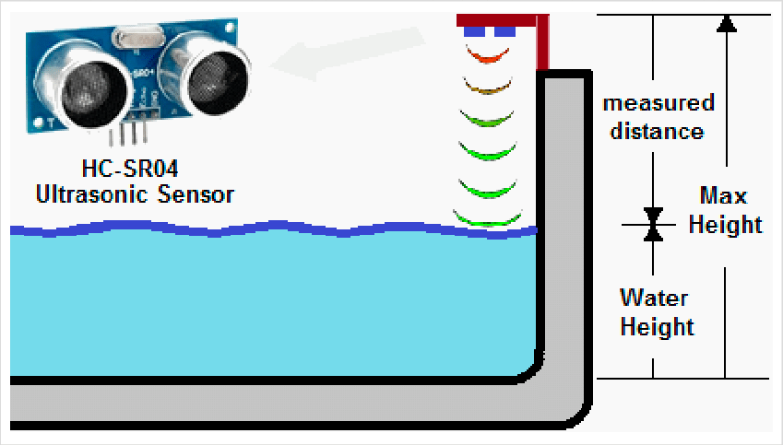
Water quality sensors: pH Sensor – Model DEF789
Flow rate sensors: Model XYZ123
Pressure sensors: Model ABC456
Turbidity Sensor - Model UVW987
Water Level sensor:DC3-5V
Distance sensor: HC-SR04 Sensor

Slide 7
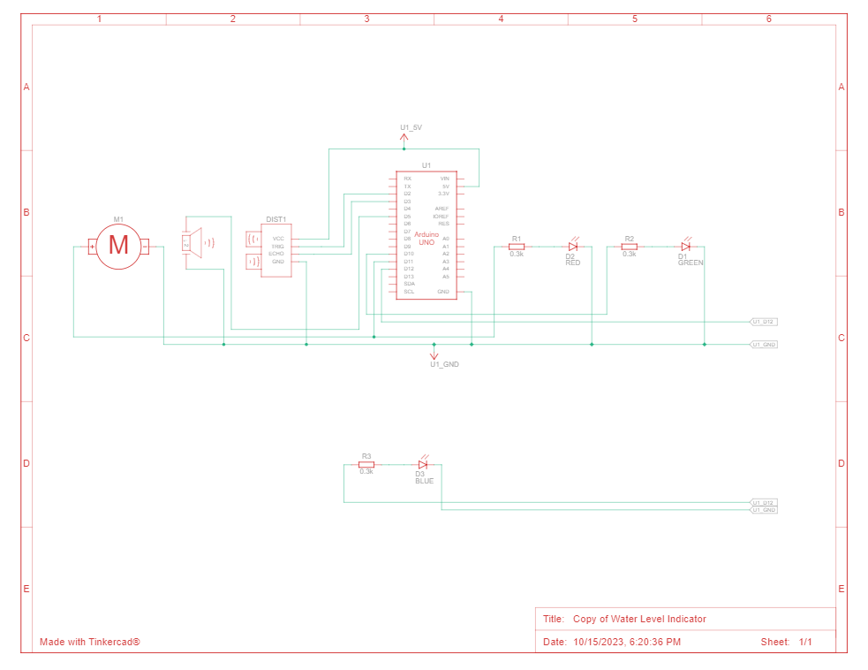
ARDUINO INTEGRATION

Slide 8
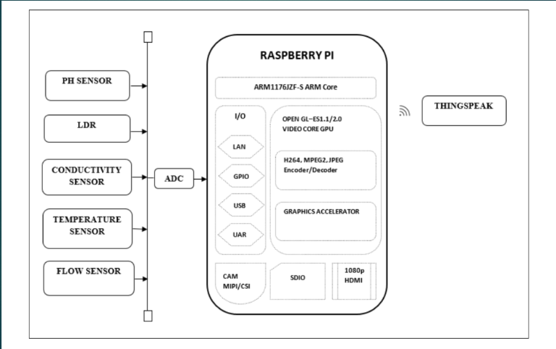
RASPBERRY PI INTEGRATION

Slide 9
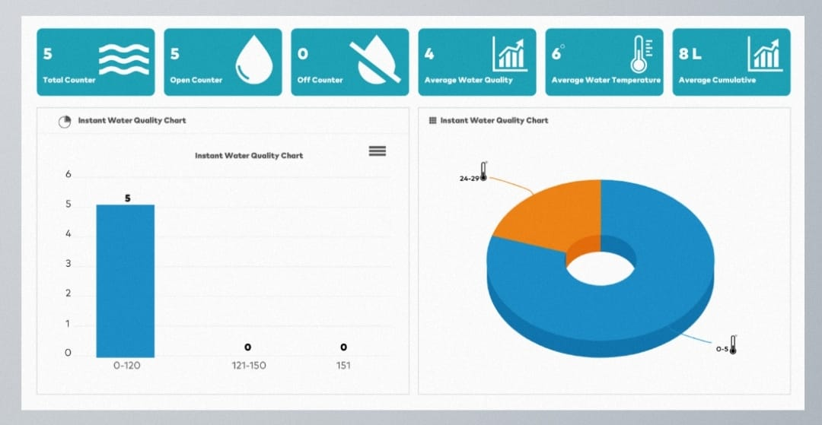
website
Click here to view my website
Click here to view code

Slide 10
HARDWARE REQUIREMENTS
SOFTWARE REQUIREMENTS
Raspberry Pi (or similar single-board computer)
Water Flow Sensor
Solenoid Valve (for controlling waterflow)
Wi-Fi Module (for internet connectivity)
Power Supply
Python (for programming)
MQTT (for communication)
Cloud server (for data storage and remote control)

Slide 11
CONCLUSION
This documentation provides a comprehensive overview of the Smart Water Fountains project includes project definition, objectives , project requirements sensor design , components used, By combining IoT sensors and connectivity, they contribute to reduced water wastage, enhanced user experience, and better resource management . These fountains offer remote control capabilities, water management and they are energy efficient.

Slide 12
THANK YOU

